Slide 1
Designing Applications in Python
Lecture 8 – Django app dev part 2
Shynggys Kairatuly Alshynov
MSc in IT
alshynov@gmail.com
CE&T department, Room 409

Slide 2
Objectives
App Overview
Views
Views with actions
render() shortcut
Raising 404 Error
get_object_or_404() shortcut
Template System
Removing static responses
Namespacing URL names

Slide 3
Learning outcomes
If someone is still reading these slides with learning outcomes then you are great!
You will improve your skills from previous lecture!

Slide 4
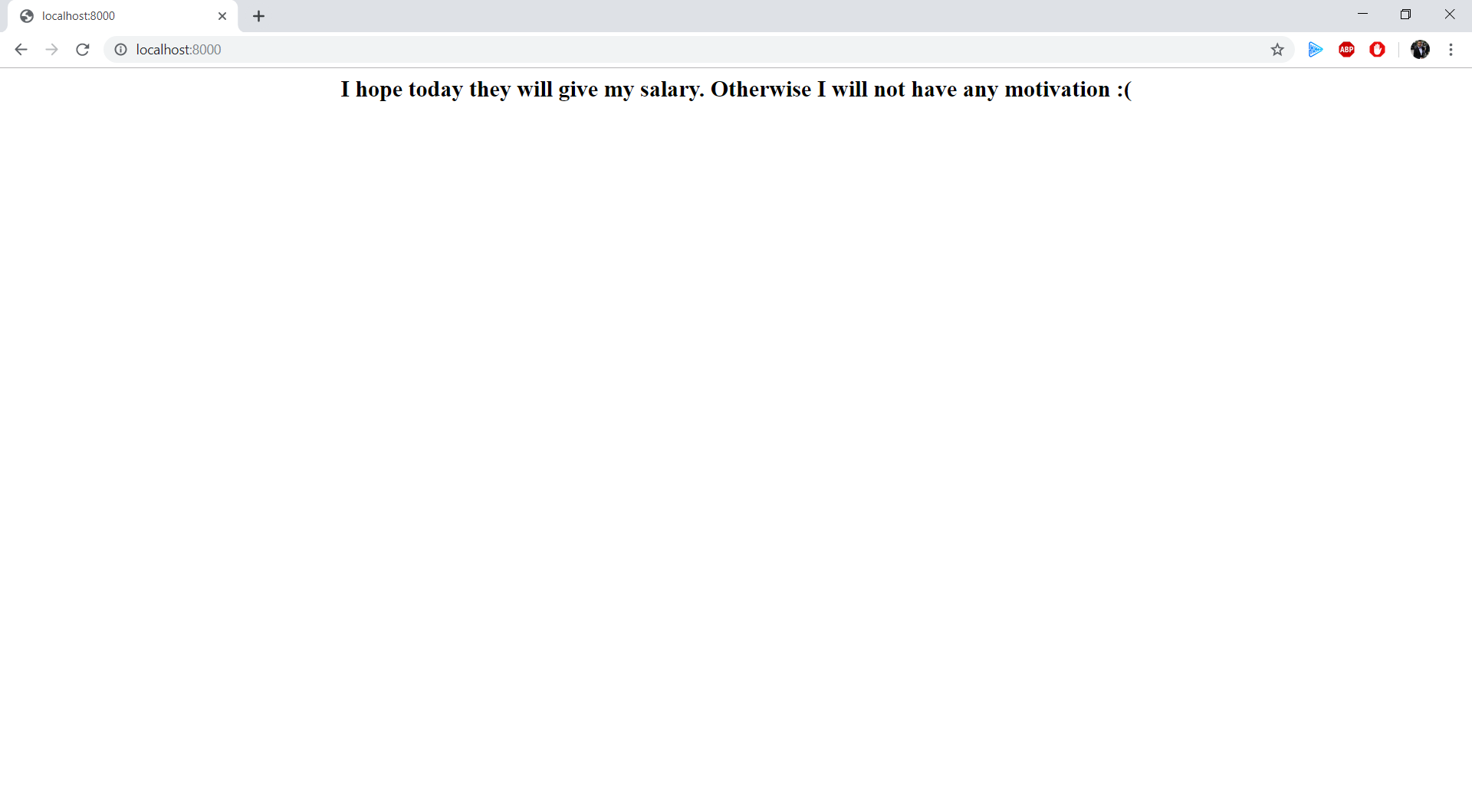
App Overview – What do we have now?
Main Page / Index Page / Welcome page
/Salary Page /

Slide 5
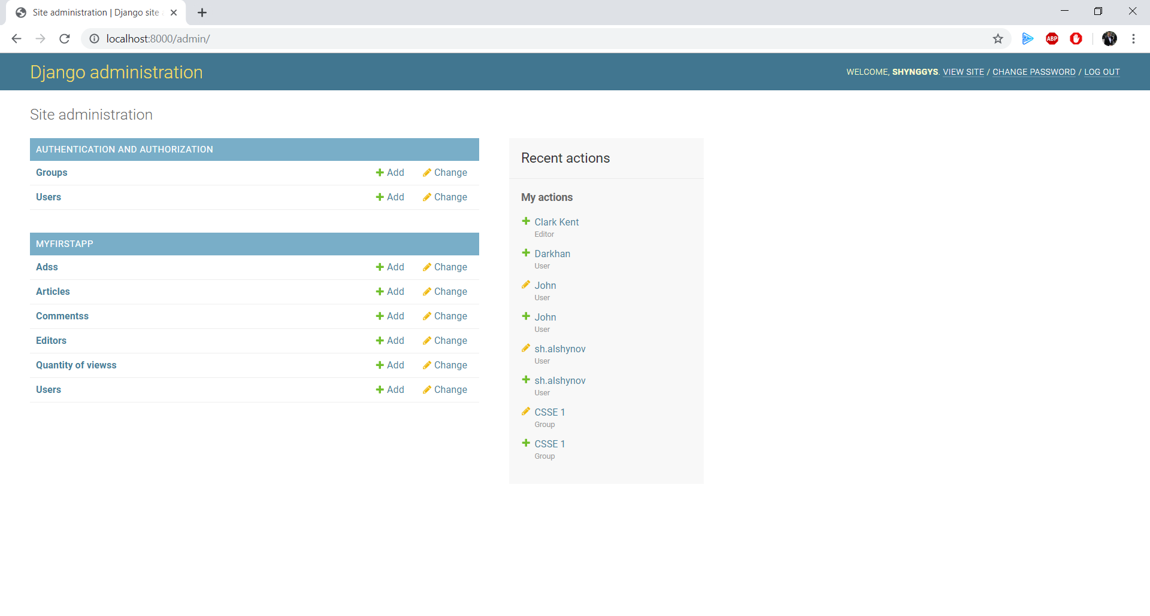
App Overview – What do we have now?
Admin Page

Slide 6
What are we going to build? (Not for sure)
Home Page – some welcome page where the main news will be placed.
Detail(Article) Page – to read fully a chosen article
Some simple searching engine – searching by article name, date or author (editor)
Archive Page – this will be the storage of all our articles
Comments part – to see the comments of people
Notes:
PYTHON IS CASE SENSITIVE DO NOT FORGET ABOUT IT

Slide 7
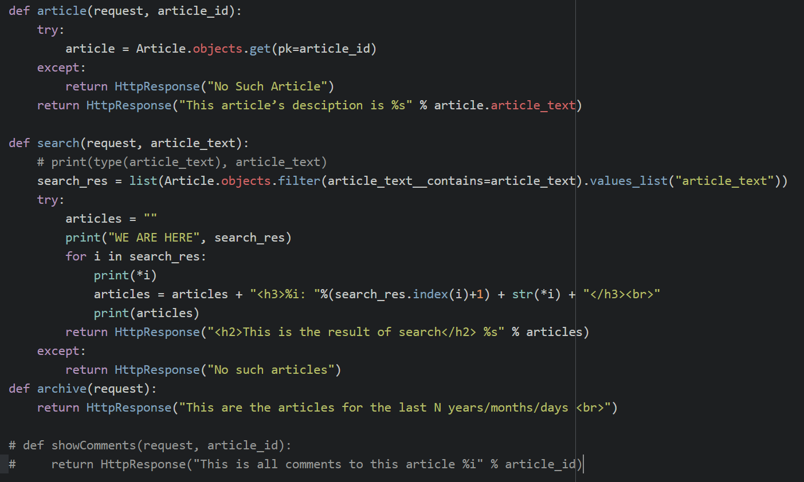
Views with action(s) – more views
Notes:
django-admin is Django’s command-line utility for administrative tasks. This document outlines all it can do.

Slide 8
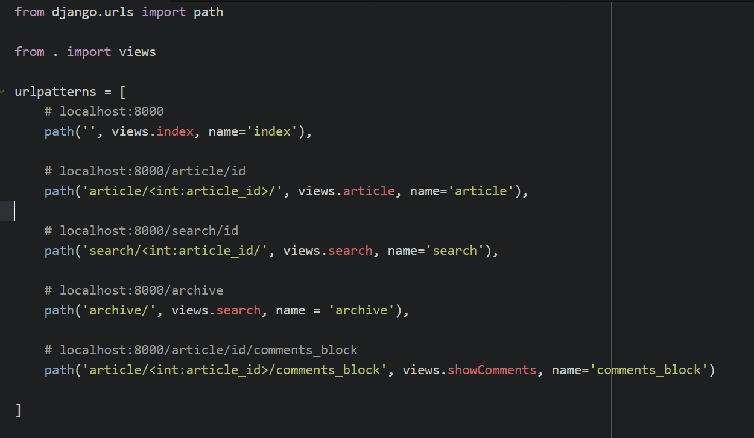
More urls in urls.py
Notes:
In addition, manage.py is automatically created in each Django project. It does the same thing as django-admin but also sets the DJANGO_SETTINGS_MODULE environment variable so that it points to your project’s settings.py file. It is a specification that describes how a web server communicates with web applications, and how web applications can be chained together to process one request.

Slide 9
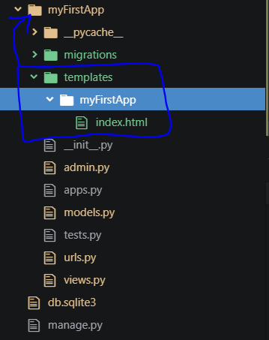
Better views - Namespacing
To create a better view with a real html templates you need to follow these steps:
Create a “templates” folder inside of your application’s folder.
Inside of this “templates” folder you need to create a folder that is identical by its name to your application’s folder.
Finally, you need to create an html file (page) inside of a new app’s folder.

Slide 10
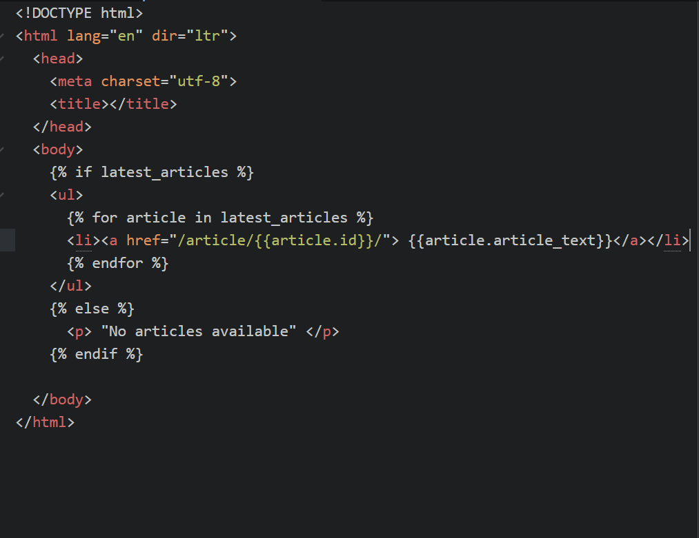
Better views – HTML page(s)
Index.html
Notes:
Your apps can live anywhere on your Python path. we’ll create our app right next to our manage.py file so that it can be imported as its own top-level module, rather than a submodule

Slide 11
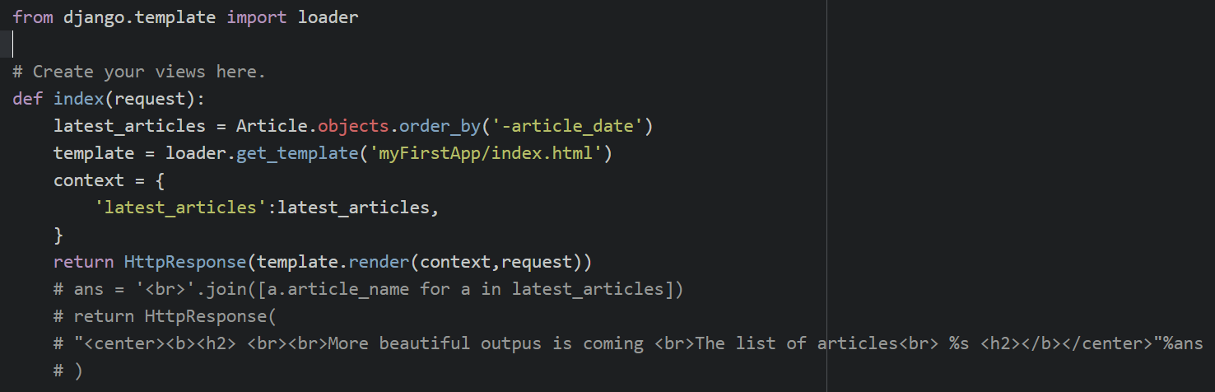
Views – Using loader.get_template()
New index view

Slide 12
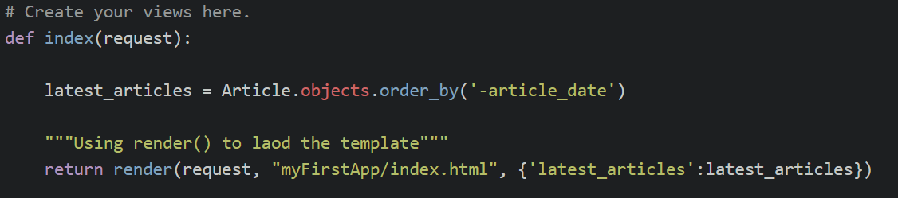
Shortcut: render()
Final index view

Slide 13
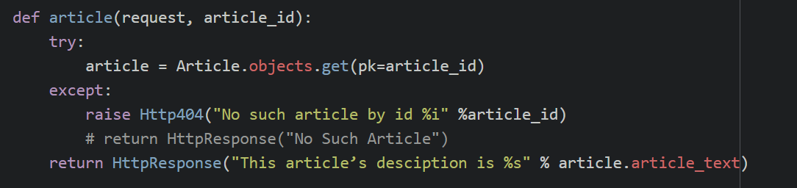
PNF 404 – using Http404()
article view using Http404

Slide 14
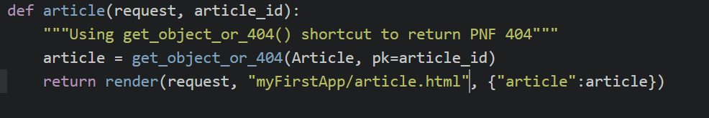
Shortcut: get_object_or_404
article view using
get_object_or_404() shortcut

Slide 15
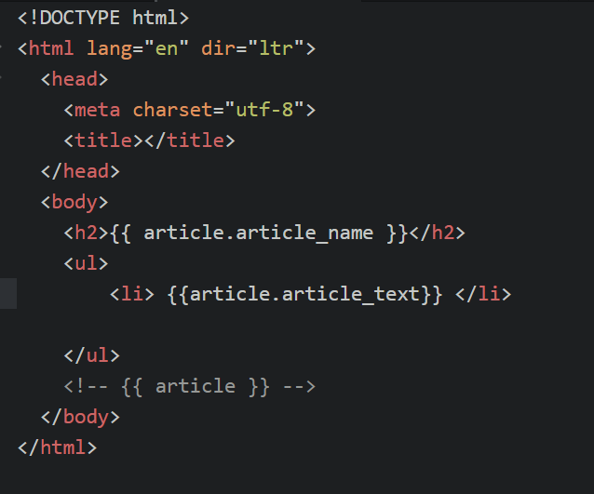
article.html page
article.html file was created inside of myFirstApp/templates/myFirstApp/article.html
Notes:
The include() function allows referencing other URLconfs. Whenever Django encounters include(), it chops off whatever part of the URL matched up to that point and sends the remaining string to the included URLconf for further processing.

Slide 16
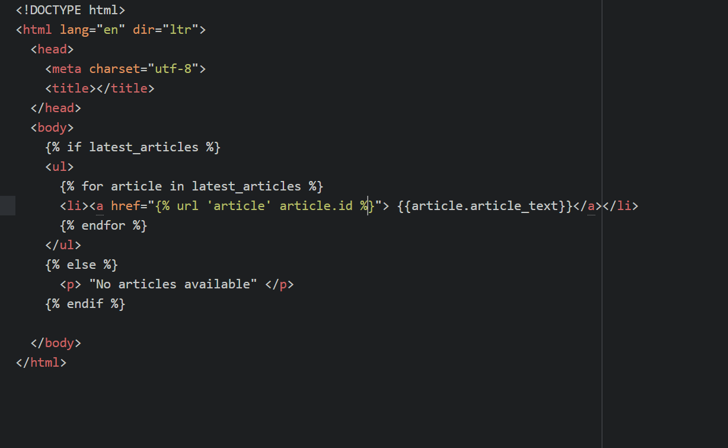
Getting rid of hardcoded links to other pages
New index.html page
Notes:
The include() function allows referencing other URLconfs. Whenever Django encounters include(), it chops off whatever part of the URL matched up to that point and sends the remaining string to the included URLconf for further processing.

Slide 17
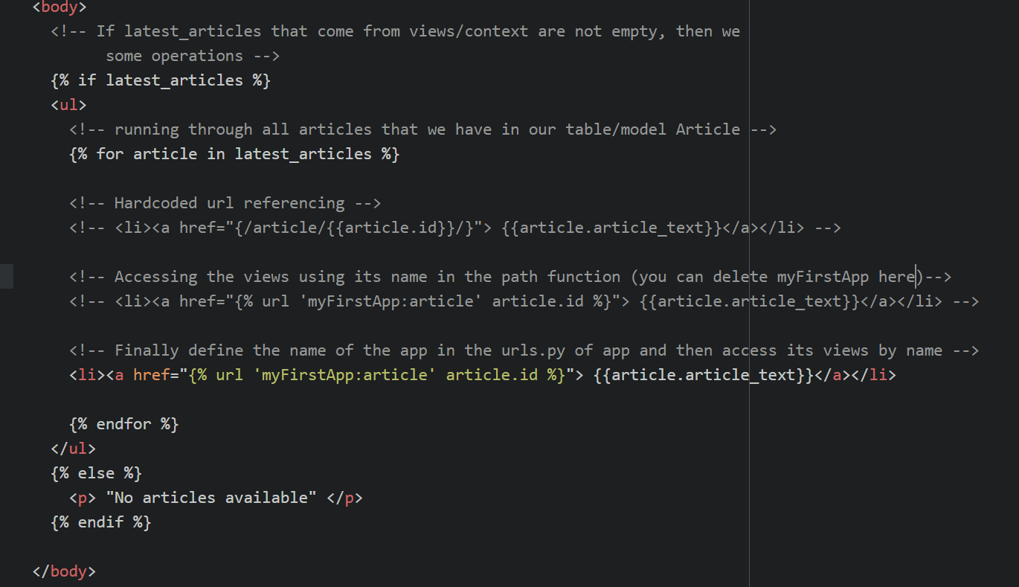
Namespaceing URL names
Final index.html page
Notes:
The path() function is passed four arguments, two required: route and view, and two optional: kwargs, and name

Slide 18

Summary
If you do not keep up, then try to do so☺

Slide 19
Some demo so far
MAKE SUPER SERIOUS FACES☺

Slide 20

Thank you for your attention!
Python is about web☺

